Slide 1
Work life balance
Notes:
Are your classroom colors different than what you see in this template? That’s OK! Click on Design -> Variants (the down arrow) -> Pick the color scheme that works for you!
Feel free to change any “You will…” and “I will…” statements to ensure they align with your classroom procedures and rules!

Slide 2

Introduction
Work–life balance is the term used to describe the balance that an individual needs between time allocated for work and other aspects of life.
-According to Wikipedia

Slide 3
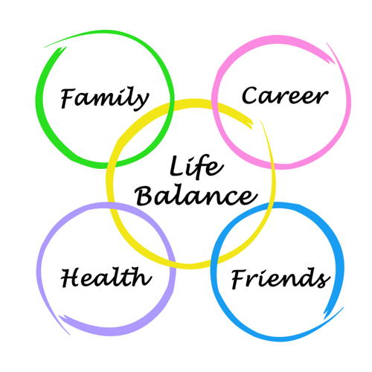
Lets Step Into……
Family:
is a group of people related either by recognized by birth
or any other relation.
Career:
A career is an individual's metaphorical "journey“
through learning, work and other aspects of life.
Health:
a person's mental or physical condition.
Friends:
a person with whom one has a bond of mutual affection.

Slide 4
Components
Self Management
Time Management
Stress Management
Change Management

Slide 5
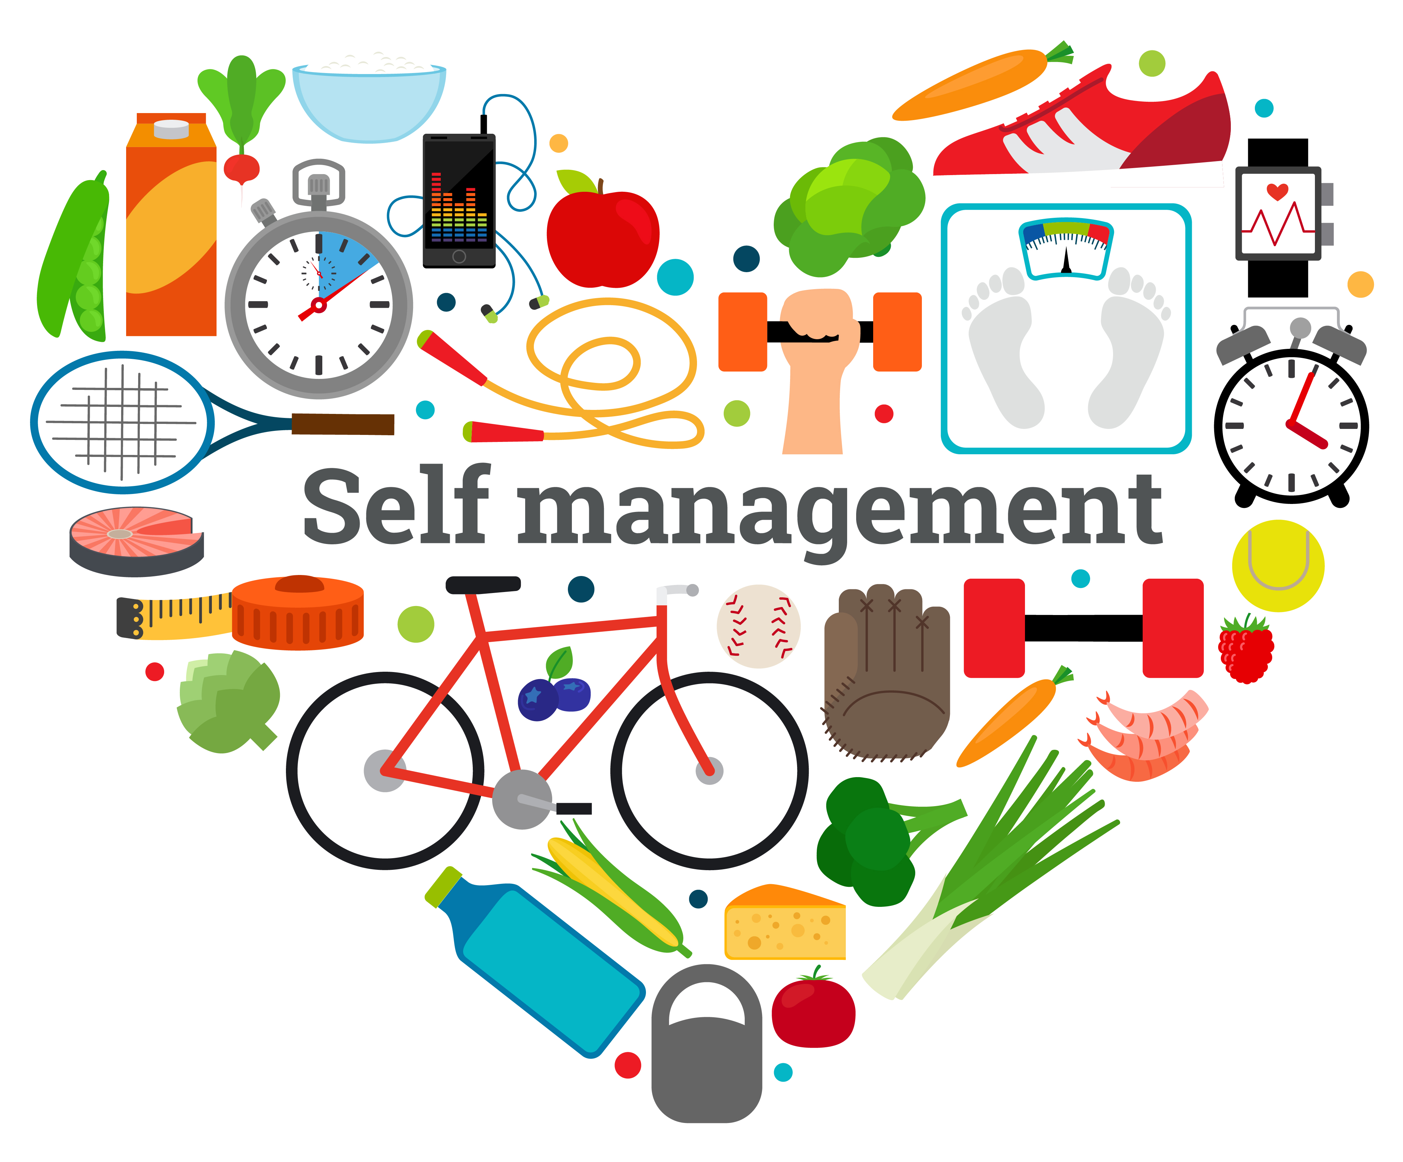

Self Management
Management by oneself of oneself or one's affairs; especially management of one's own care or well-being.
Time Management
The ability to use one's time effectively or productively,
especially at work.

Slide 6
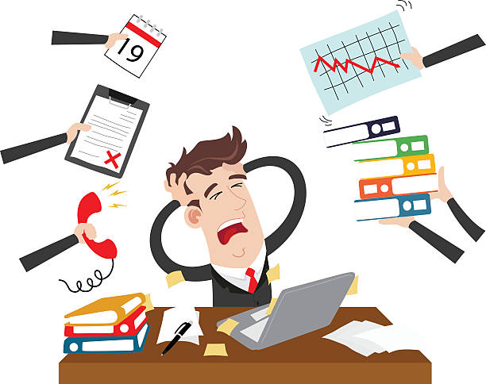

Stress Management
Stress management is a wide spectrum of techniques and psychotherapies aimed at controlling a person's level of stress, especially chronic stress, usually for the purpose of improving everyday functioning
Change Management
The management of change and development within a
business or similar organization or individual (self)

Slide 7
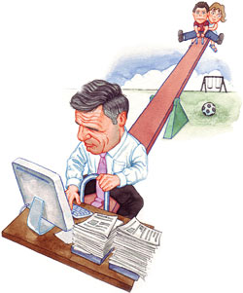
Work Life Imbalance
An im-balance is fundamentally a lack of clearly defined and consistently enforced boundaries between
work life and personal life. When we fail to have a healthy work life balance, people end up experiencing
emotional stress and depression.
The main reason is work stress.
Reasons
Competition
Organizational Factor
Family Issues Factor
Individual Factor
Work Issue Factor

Slide 8
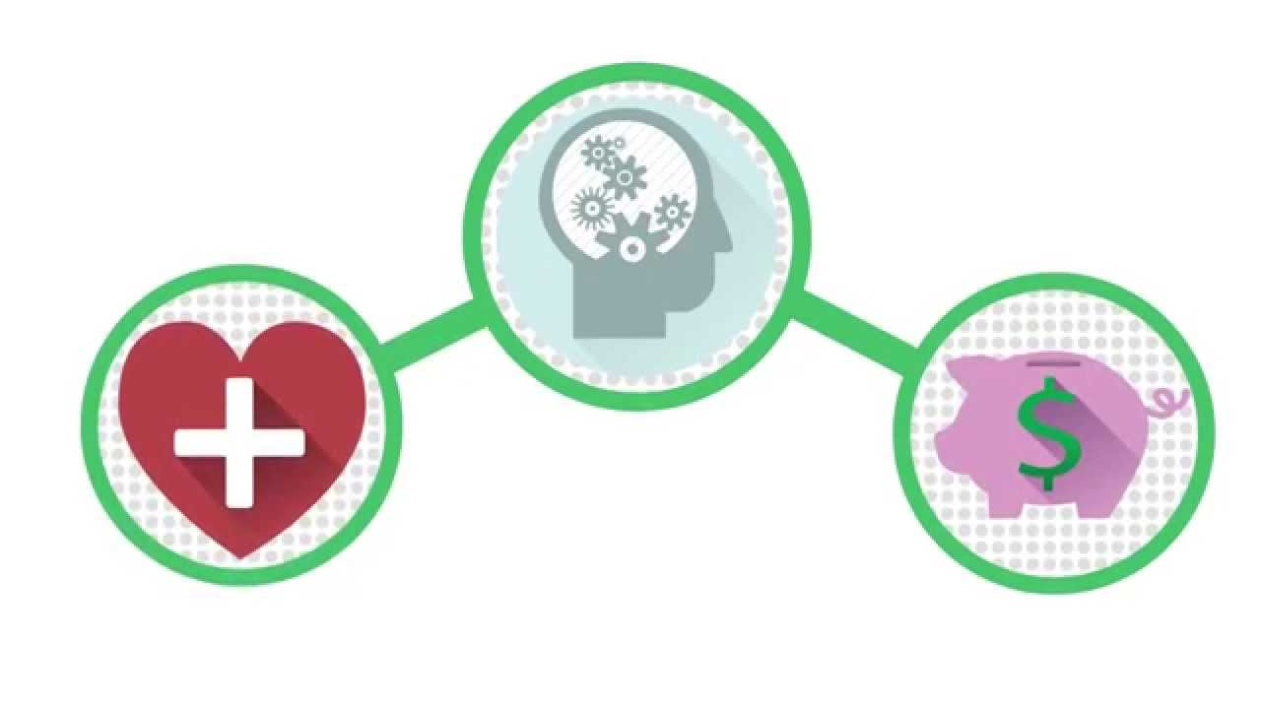
Consequences Work Life Imbalance
Health Risk
Obesity
Exhaustion
Emotional Problem
Absenteeism
Burnout
Stress

Slide 9

Other Causes
Less Family Participation
Limited Friendship
Distance In Personal Relation
Chances (No Appreciation)

Slide 10

Lets Consider Our Self As An Employer
Scheduling
Compressed Workweeks
Health and Wellness
Appreciation & Co-ordination
Personal Growth and Development

Slide 11
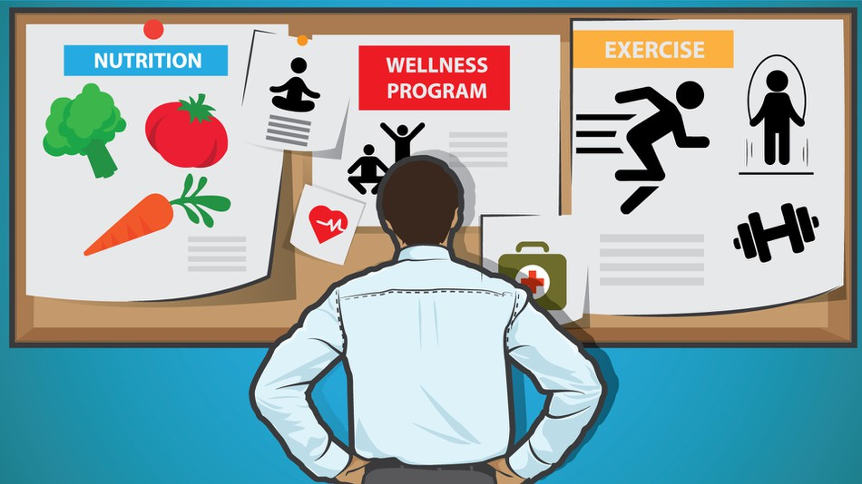
Strategies To Implement Work Life Balance
Put the best work , First
Exercise and Health Care
Prioritize Your Work
Make Time for Yourself
Keep an Updated Schedule

Slide 12
Conclusion
Work life balance is at best an elusive ideal and at worst a complete myth. But by making deliberate choices about which opportunities to pursue and which to decline, rather than simply reacting to emergencies, leaders can and do engage meaningfully with work , family and community.
Through work life balance the individual will feel relaxed and organized.
It will improve relationship with family and friends.
Work impacts quality of life (e.g., family, friends organization).

Slide 13
Reference
https://en.wikipedia.org/wiki/Work%E2%80%93life_balance
https://www.theladders.com/career-advice/the-real-reason-for-work-life-imbalance-and-3-solutions
https://www.okanagan.bc.ca/Assets/Departments+(Administration)/Public+Affairs/College+Matters/All+About+Us/2012-June+30+2013/PPC+Balance+Sheet+Apr+2012.pdf

